Slide 1

Shir Hadash Customer Focus Study

Slide 2
Outline
Current State
Objectives
Benefits
Program Charter
Program Roadmap
Program Governance
Staffing Plan
Funding Plan
Project 1 Overview

Slide 3
Current State
Shir Hadash is located in one of the most densely populated Jewish areas in the nation, yet it continues to struggle with attracting new members.
Membership retention continues to plague the organization (especially with families who bar/bat mitzvah their children).
The value proposition for products & services is not clear.
Reconstructionist congregations are based on participation, but most of the volunteers come from the same individuals.
The current economic downturn has put increased pressure on our budget and revenue opportunities.
We are not able to pursue a building due to our limited financial capabilities.

Slide 4
Objectives
Leverage a disciplined approach for understanding what customers (member, prior members, and non-members) want from a Reconstructionist Congregation.
Build a repeatable process for SH to measure how well their products & service address the desired customer outcomes.
Rationalize the existing products & services to assess how well SH is addressing the value needs of customers today.
Provide a discipline for SH leadership to identify and prioritize future opportunities to build loyalty with existing members and attract new members.
Introduce a set of tools for SH leadership to create the right products & services to address the future opportunities.

Slide 5
Scope
The president & board of directors approved the following 3 areas to be studied:
Religious Services
Friday night services
High Holiday services
Bar/Bat Mitzvah services
Community Services
Membership outreach
Membership inreach
Educational Services
Religious School
Continuing education for post mitzvah
Continuing education for adults

Slide 6
Approach
Understand customer needs
Identify Opportunities
(Prioritize)
Generate ideas
Create new products & services
Deliver new value to customers

Slide 7
Benefits
Improve the value delivered by SH for:
Religious Services
Community Services
Education Services
Provide SH with a disciplined and repeatable process for measuring the value of their services (w/in the above scope) going forward.
Leverage available resources in a more efficient manner to build a loyalty program for improving membership retention and attracting prior members and new members.
Establish a pipeline of opportunities to engage SH leaders and members to create new ideas used to deliver new products & services in the future.

Slide 8
Project Overview

Slide 9
Program Charter
Program Charter | Developing New Products & Services to drive membership for SH
Project Number | SH - 001 | Charter Date | August 21st, 2009
Program Sponsor | SH Board of Directors | Program Director | Jeff Wallk
Program Scope | Design and implement a customer focus framework for capturing and modeling metrics used to model the outcomes for customers and a set of metrics for which to benchmark the products & services delivered by EA practitioners.\
Objectives | Implement a customer focus methodology Create a reference model for identifying customer outcomes and metrics for measuring value Define a complete list of jobs performed by members Create a repository of customer outcomes & value metrics Develop a process to prioritize and align the outcomes & metrics with GAPS in products & services Develop a licensing program to promote the usage of outcomes & drive revenue for CAEAP
Governance | Establish a steering committee with members from the BOD and Practice Worksttream Create a small team of dedicated trained resources to staff each project Project lead will be the Program Director Steering Committee will approve scope, program objectives, and project deliverables (Note: Each project represents 1 job that will be studied to capture the outcomes & value metrics

Slide 10
Program Roadmap
Q3 2009
Draft the proposal for the work stream
Obtain approval from SH leadership
Build a steering committee for the program
Finalize scope for the program
Q4 2009
Conduct a Job Study (w/ program scope)
Prioritize the list of jobs
Communicate to the organization
Finalize project schedule
Draft resources for the project team
Begin work on initial deliverables

Slide 11
Program Roadmap
Q1 2010
Complete qualitative study for Project 1
Complete quantitative study for Project 1
Conduct analysis of Project 1 results
Present Project 1 results to SH leadership
Publish results for Project 1 to Public
Conduct ideation to identify new products & services
Present ideas to SH Board for review & approval
Q2 2010
Develop new products & services
Move forward with next project(s)

Slide 12
Program Governance
BOD
Program
Steering Committee
Program
Director

Slide 13
Staffing Plan
Steering Committee
Jeff Wallk
Kaye Kharach
Molly Michaels
Jill Antoni
Melanie Andes
Project Team
Jeff Wallk (commitment of 10 hours / week)
Volunteer 1 (commitment of 6 hours / week)
Volunteer 2 (commitment of 4 hours / week)

Slide 14
Funding Plan
The project is positioned as a zero cost since SH has no available funding dollars for the study in 2009. However, there are other options we may want to pursue:
Reach out to JRF (Jewish Reconstructionist Federation) for funding and/or grant monies.
Value prop (share insights w/ JRF, doesn’t impact existing members)
Seek funding from the existing membership
Value prop (better products & service delivery)
Seek funding from Government sources (grant money)
Value prop (doesn’t impact existing members)
Obtain funding in the 2010 budget
Long shot…but might be worth a shot if we can demonstrate value in 2009.

Slide 15
Key Milestones & Delierables
Qualitative Phase:
Job Study for Project Scope
Prioritize the jobs to study
Develop an interview plan
Conduct interviews (capture outcomes)
Analyze outcomes & complete analysis
Quantitative Phase:
Draft survey (using outcomes)
Conduct survey (measure outcomes)
Analyze results & identify opportunities
Present findings to Board of Directors (BOD)
Based on the Strategyn Methodology (see appendix)

Slide 16
Key Milestones & Delierables
Establishing the opportunity pipeline
Prioritize the list of opportunities
Introduce tools for generating ideas (to address opportunities)
Conduct an open innovation competition (to generate ideas)
Steering Committee to select the best ideas
Provide recognition to contestants
Select the best ideas & agree upon list of recommendations to pursue
Present top ideas to SH Board with recommendations
Transition ideas to innovation
Gain board approval to pursue recommendations
Board assigns ownership to develop & implement changes
Create new products & services
Modify existing products & services
Eliminate existing products & services

Slide 17
Appendix
(Overview of Strategyn Methodology)

Slide 18
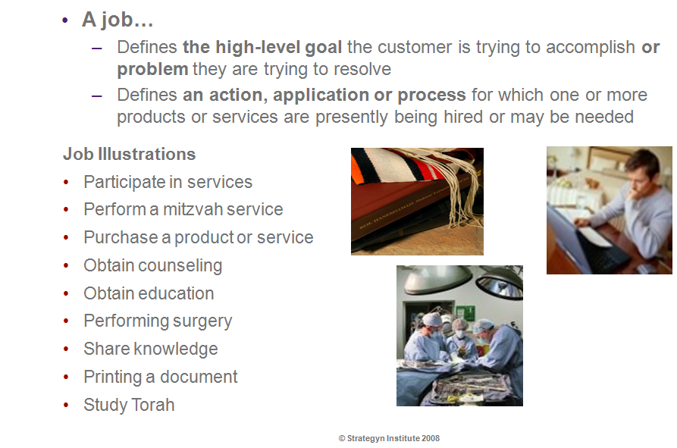
What is a Job ?

Slide 19
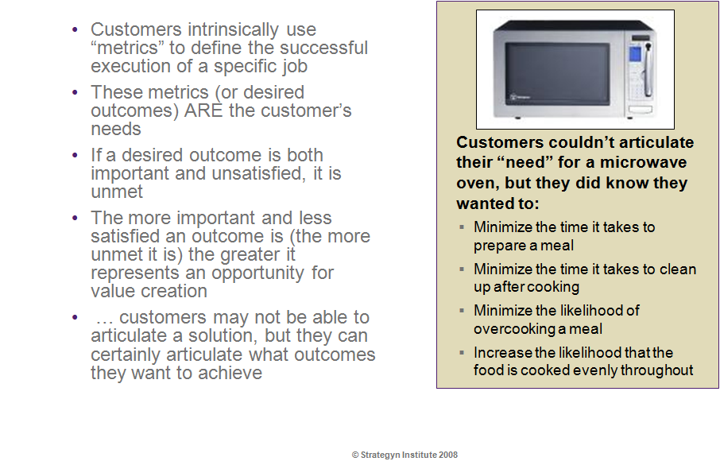
What are outcomes ?

Slide 20
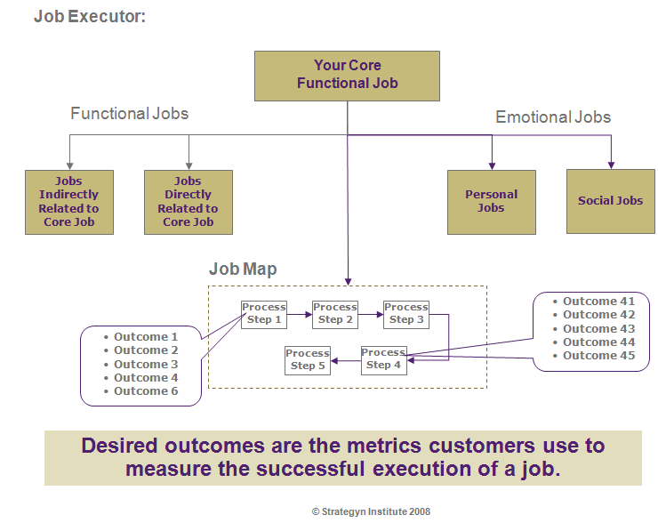
Model for Relating Jobs & Outcomes

Slide 21
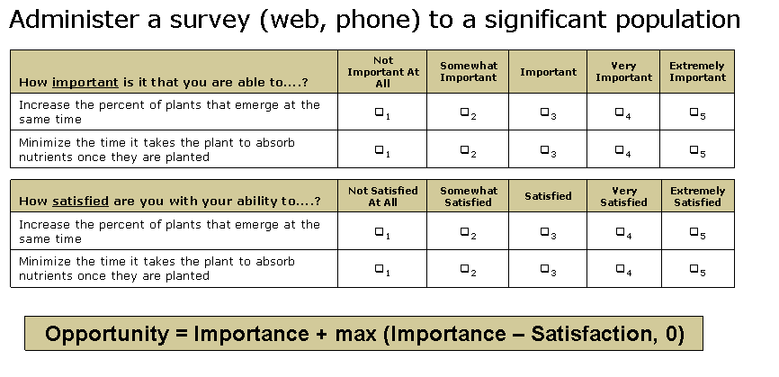
Capturing & Measuring Value

Slide 22
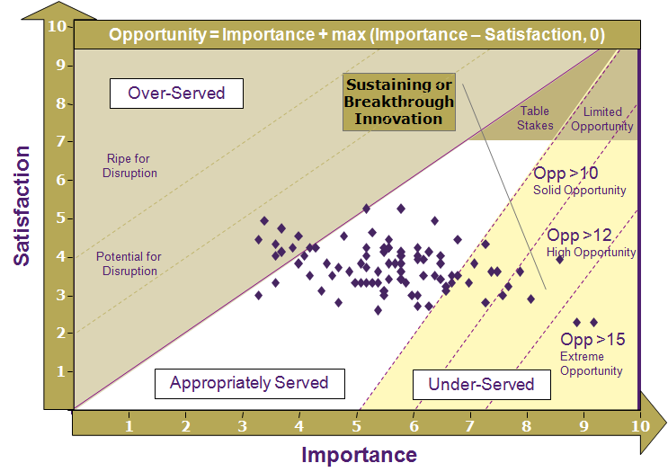
Identifying & Prioritizing Opportunities

Slide 23
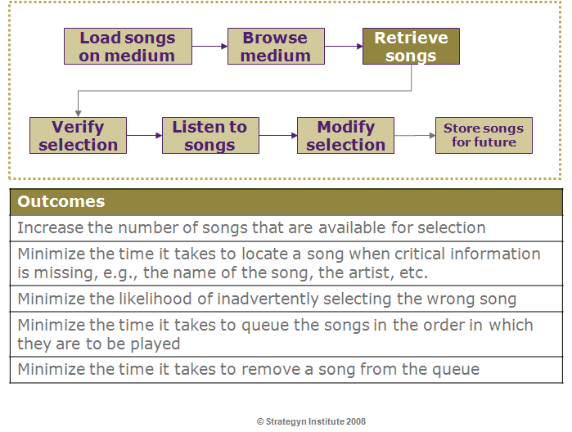
Example: Job of Storing & Retrieving Music

